Slide 1
SYSTEM DESIGN

Slide 2
Key Definitions
Architecture design
  Plans for how the system will be distributed across computers and what the hardware and software will be used for each computer.
Hardware and software specification
  Describes the hardware/software components in detail to aid those responsible for purchasing those products.
Interface
  The user interface defines how the system will interact with external entities.
  The system interfaces define how systems exchange information with other systems.

Slide 3
Architectural Components
(Functions) of Software
Data storage
Data access logic
  Processing required to access stored data
Application logic
  Processing logic of the application
Presentation logic
  Information display and user command processing

Slide 4
Architectural Design Purpose
Determine what parts of the application software will be assigned to what hardware.
Hardware options:
  Clients
    Input/output devices employed by users
    PCs, laptops, handheld devices, cell phones
  Servers
    Larger computers storing software
    Accessible by many users

Slide 5
Client-Server Architectures

Slide 6
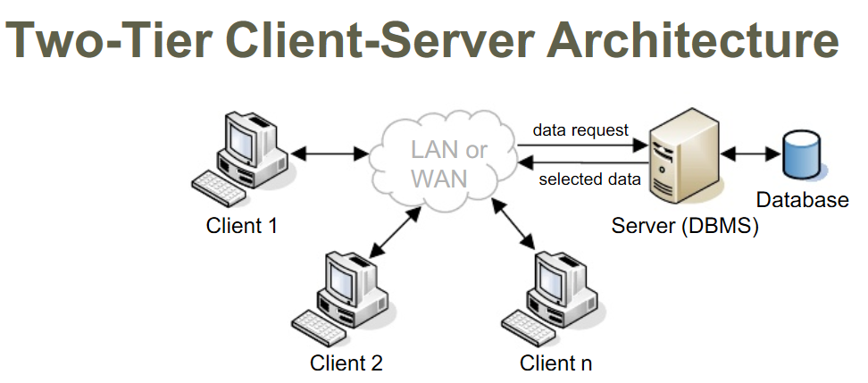
Client-Server Architecture (Two-Tiered)

Slide 7
Client-Server Attributes
Benefits
Limitations
Scalable
Works with multiple vendors/products through middleware
Improved modularity of web-based systems
No central point of failure
Complexity
New programming languages and techniques (adds stress for personnel)
More complex to update

Slide 8
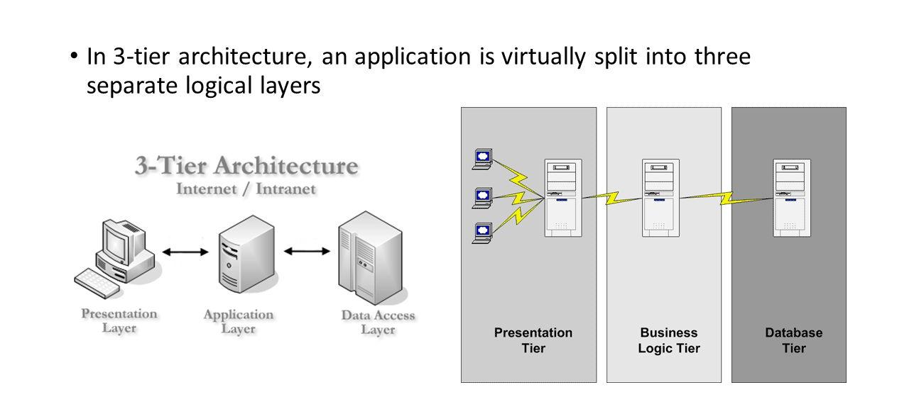
Three-Tiered Client-Server
Architecture

Slide 9
N-Tiered versus 2-Tiered Client-
Server Architectures
Benefits
Limitations
Separates processing to better balance load on different servers.
More scalable.
Greater load on the network
More difficult to program and test

Slide 10
Factors in Hardware and Software
Selection
Functions and Features – What specific functions and features are needed (size of monitor, software features …)
Performance – How fast the hardware and software operates (processor, number of database writes per second …)
Legacy database and systems – How well the hardware and software interacts with legacy systems (can it writes to this database …)
Hardware and OS strategy – What are the future migration plan
Cost of ownership – What are the cost beyond purchase (incremental license cost, annual maintenance, training cost …)
Vendor performance

Slide 11
User interface

Slide 12
Key Definitions
The navigation mechanism provides the way for users to tell the system what to do.
The input mechanism defines the way the system captures information.
The output mechanism defines the way the system provides information to users or other systems.

Slide 13
Principles for user interface design
Layout Concepts
  The screen is often divided into three boxes.
    Navigation area (top)
    Status area (bottom)
    Work area (middle)
  Information can be presented in multiple areas.
  Like areas should be grouped together

Slide 14
Principles for user interface design
Layout Concepts
  Areas and information should minimize user movement from one to another.
  Ideally, areas will remain consistent in
    Size
    Shape
    Placement for entering data
    Reports presenting retrieved data

Slide 15
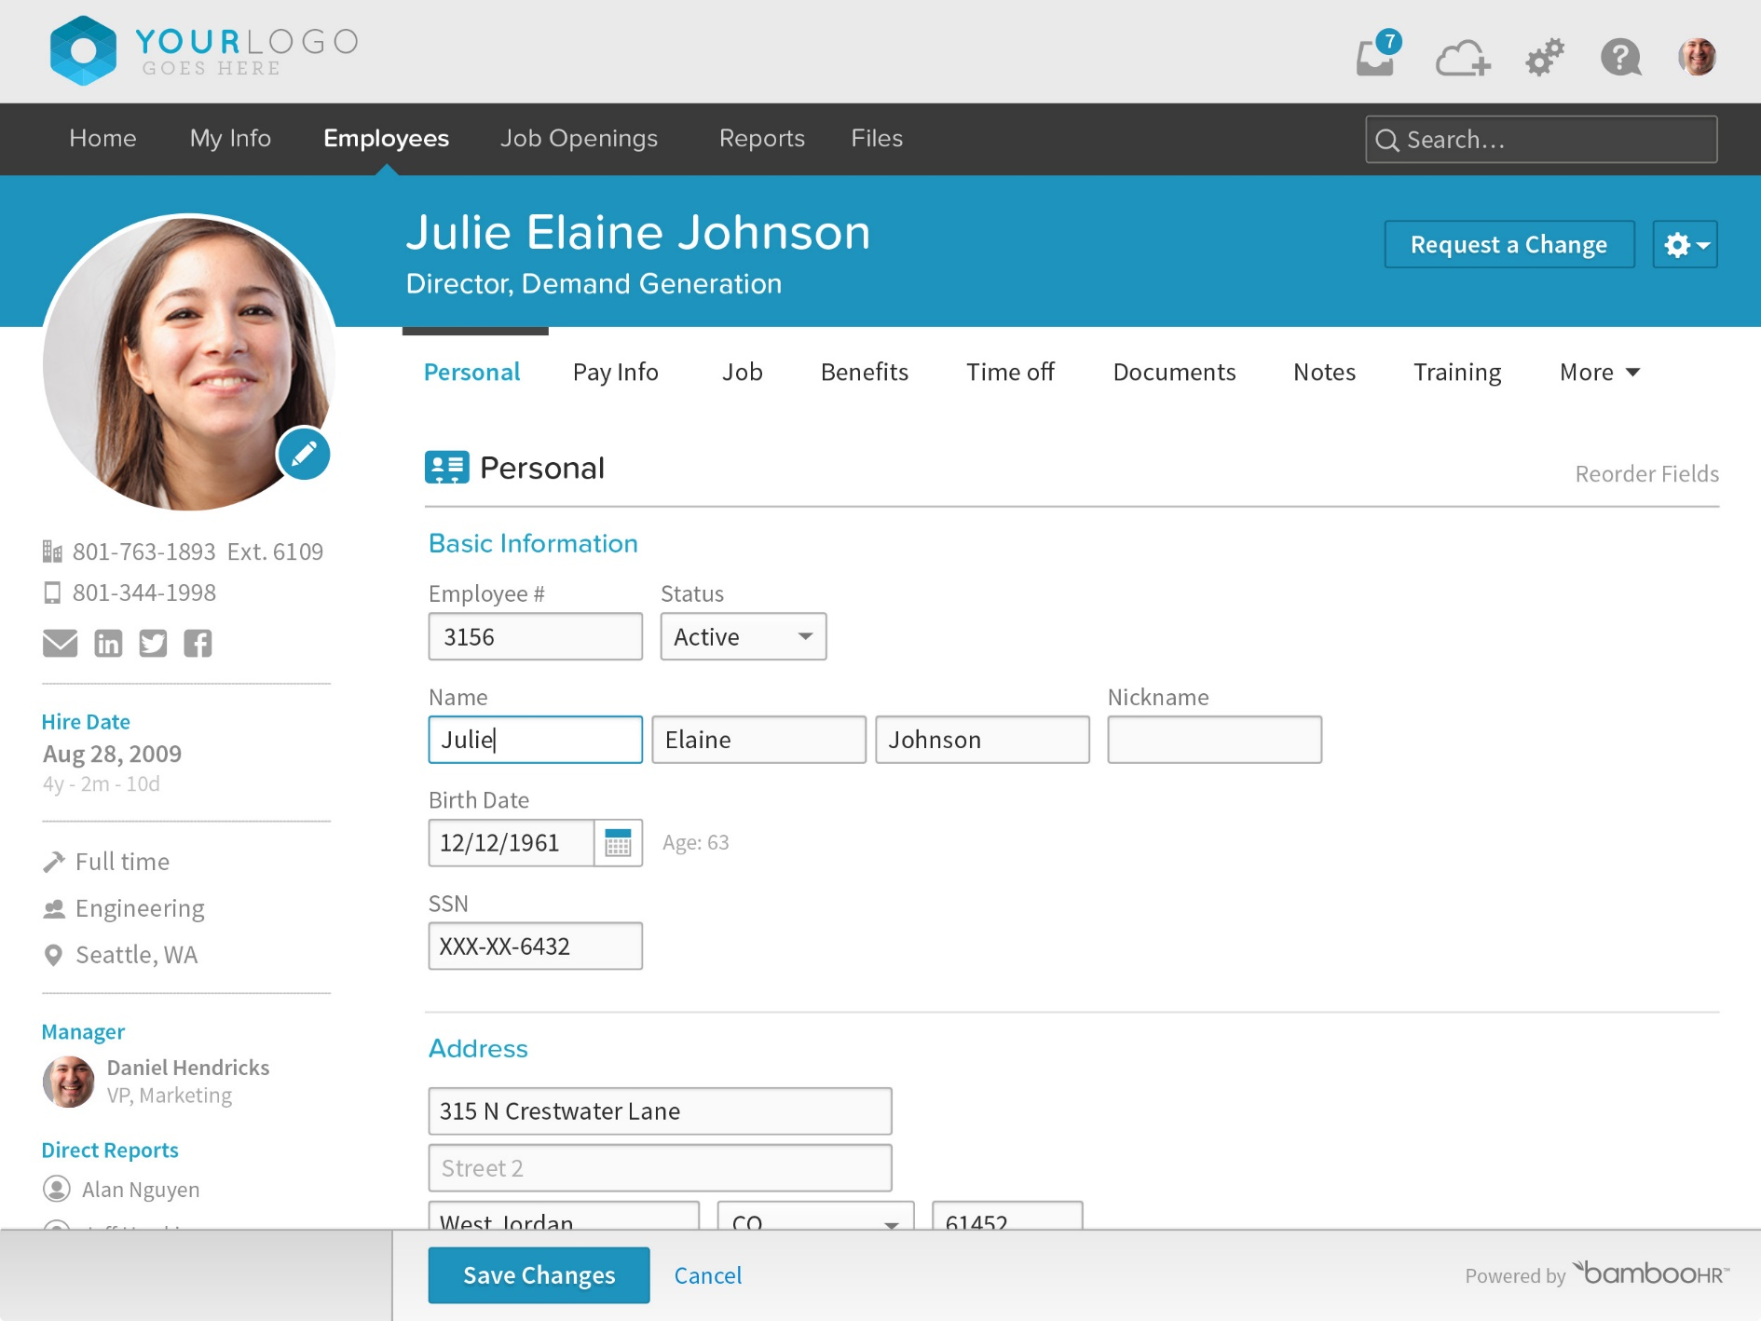

Slide 16
Principles for user interface design
Content Awareness
  All interfaces should have titles.
  Menus should show where you are where you came from to get there.
  It should be clear what information is within each area.
  Fields and field labels should be selected carefully.
  Use dates and version numbers to aid system users.

Slide 17
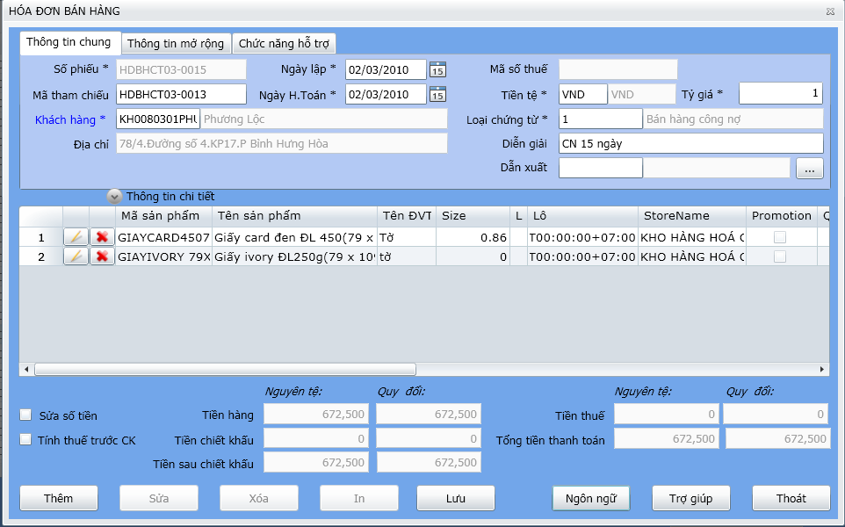

Slide 18
Principles for user interface design
Aesthetics
  Interfaces need to be functional and inviting to use
  Avoid squeezing in too much, particularly for novice users
  Design text carefully
    Be aware of font and size
    Avoid using all capital letters

Slide 19
Principles for user interface design
Aesthetics
  Colors and patterns should be used carefully
    Test quality of colors by trying the interface on a black/white monitor
    Use colors to separate or categorize items

Slide 20
Principles for user interface design
Three clicks rule
  Users should be able to go from the start or main menu of a system to the information or action they want in no more than three mouse clicks or three keystrokes.

Slide 21
NAVIGATION DESIGN
Basic Principles of Navigation Design
  Assume users
    Have not read the manual
    Have not attended training
    Do not have external help readily at hand
  All controls should be clear and understandable and placed in an intuitive location on the screen.

Slide 22
NAVIGATION DESIGN
Basic Principles of Navigation Design
  Prevent mistakes
    Limit choices
    Never display commands that can’t be used (or “gray them out”)
    Confirm actions that are difficult or impossible to undo
  Simplify recovery from mistakes
  Use consistent grammar order

Slide 23
NAVIGATION DESIGN
Types of Navigation Control
  Languages
    Command language
    Natural language
  Menus
    Generally aim at broad shallow menu
    Consider using “hot keys”
  Direct Manipulation
    Used with icons to start programs
    Used to shape and size objects
    May not be intuitive for all commands

Slide 24
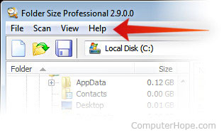
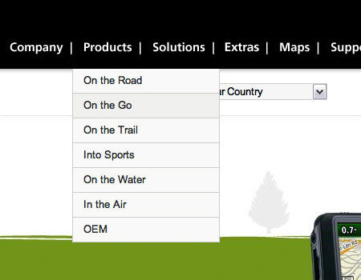
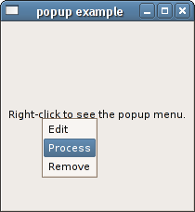
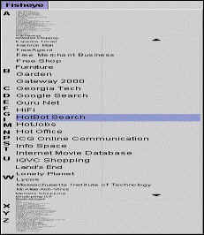
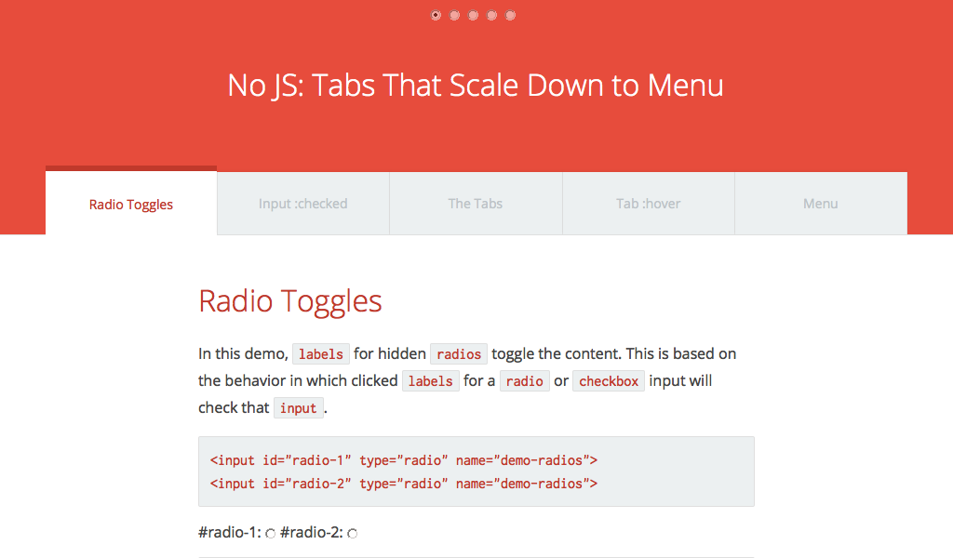
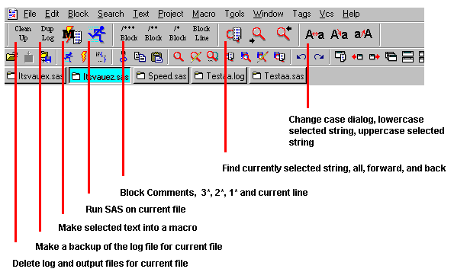
NAVIGATION DESIGN
Types of Menus

Slide 25
Message tips
Should be clear, concise, and complete
Should be grammatically correct and free of jargon and abbreviations
Avoid negatives and humor

Slide 26
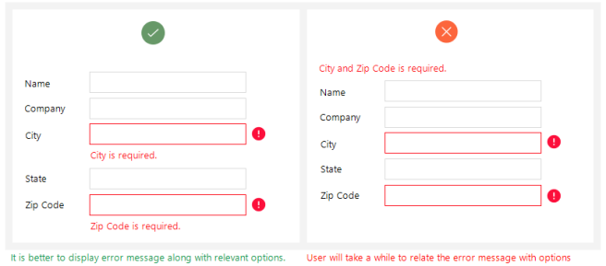
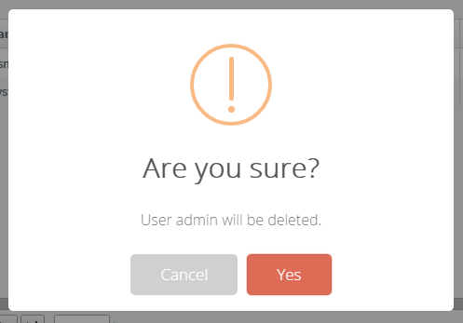
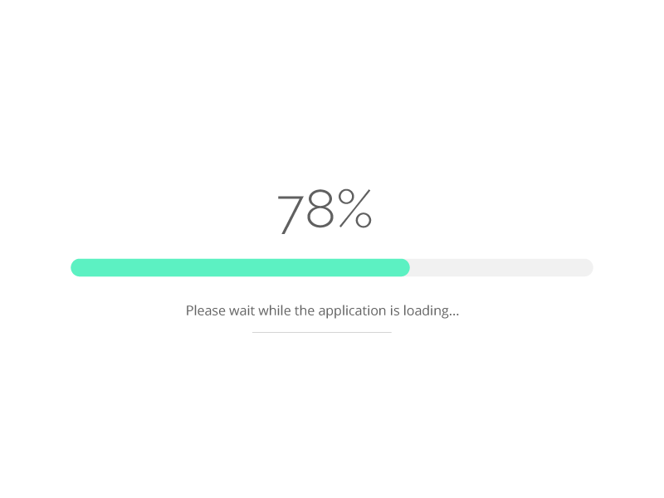

Types of Messages

Slide 27
Input design
The goal is to simply and easily capture accurate information for the system
Reflect the nature of the inputs
Find ways to simplify their collection
Online processing immediately records the transaction in the appropriate database
Batch processing collects inputs over time and enters them into the system at one time in a batch

Slide 28
Input design
Minimize Keystrokes
  Never ask for information that can be obtained other ways
    Lookups
    Dropdown lists
    Default values

Slide 29
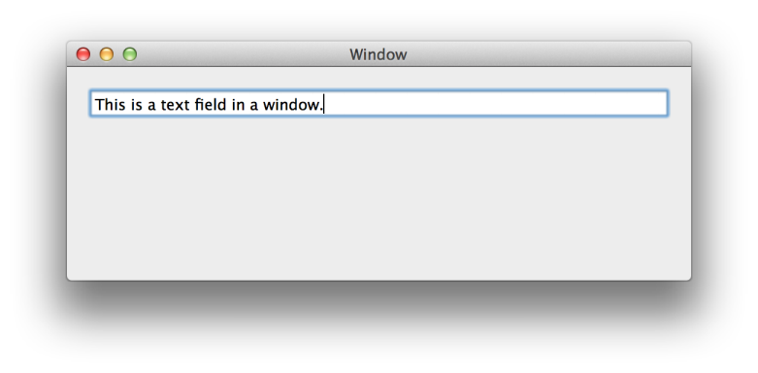
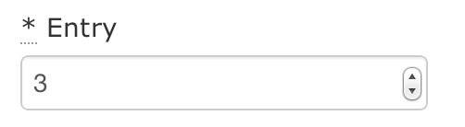
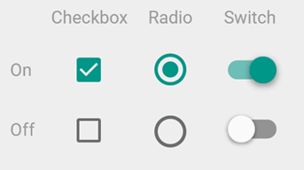
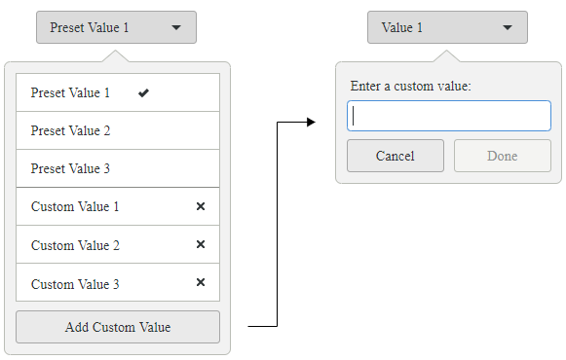
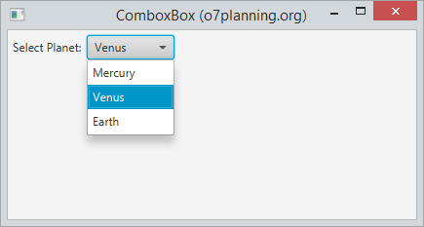
Types of inputs

Slide 30
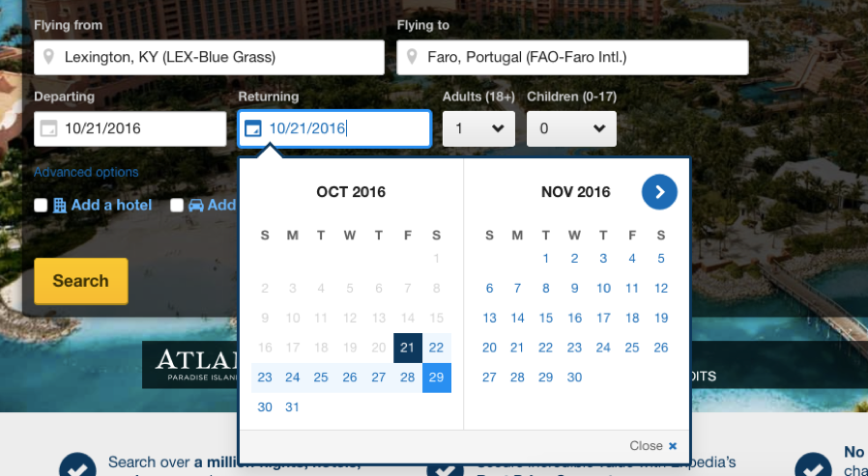

Slide 31
Output design
Understand report usage
  Reference or cover-to-cover?
  Frequency?
  Real-time or batch reports?
Manage information load
  All needed information, no more
  Minimize bias

Slide 32
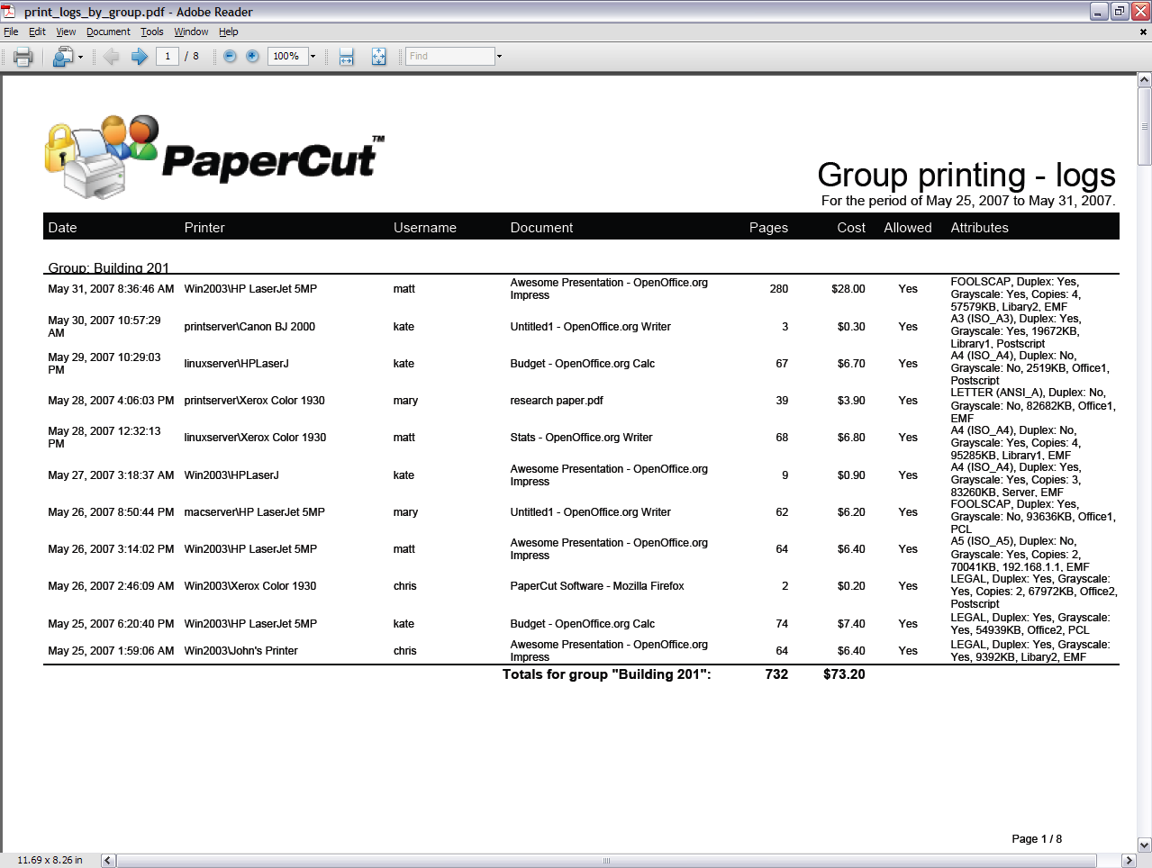
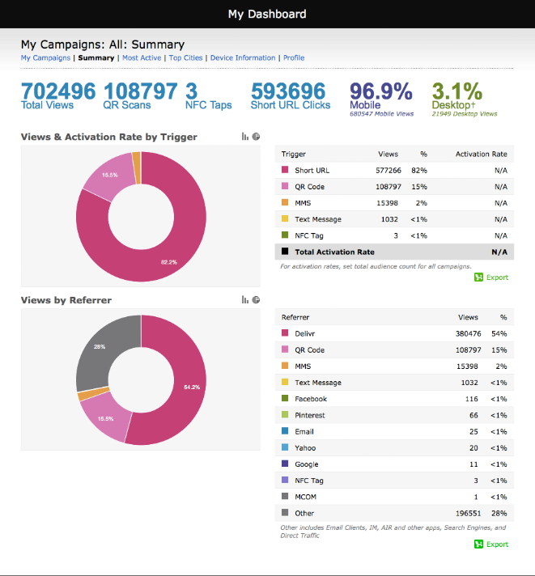
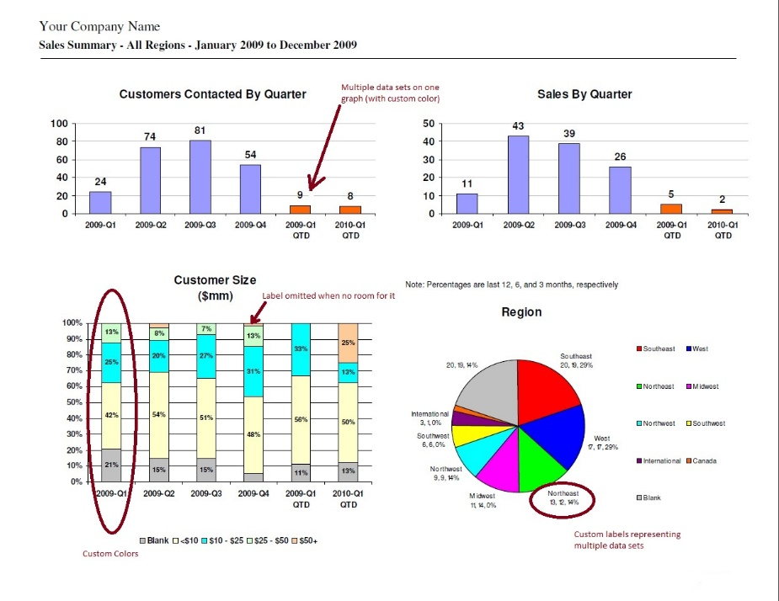
Types of reports

Slide 33
Physical data design

Slide 34
Clustering
Reduce the number of times storage must be accessed by physically placing like records close together.
  Intrafile clustering – similar records in a table are stored together
  Interfile clustering – combine records from more that one table that are typically retrieved together

Slide 35
Indexing
A minitable that contains values from one or more fields in a table and the location of the values within the table
Similar to the index of a book.
For each table, create a unique index that is based on primary key.
For each table, create an index that is based on foreign key to improve the performance of joins.
Create an index of fields that are used frequently for grouping, sorting or criteria.

Slide 36
Estimating Storage Size
Raw data – sum of the average widths of all fields in a table.
Calculate overhead requirements based on DBMS vendor recommendations
Estimate initial number of records
Estimate growth rate of records

Slide 37
Calculating Volumetrics

Slide 38
No | Attribute | Data type | Size | Decimal places | Default value | MIN | MAX | Primary | Unique | NOT NULL | Foreign key | Description

